Slide 1
Project name
Your Name

Slide 2
Put short CV

Slide 3
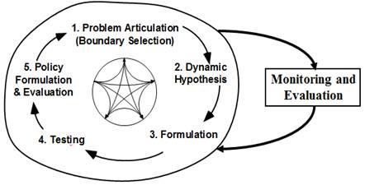
Steps in System Dynamics Modeling Process
The research methodology adopted is in accordance to the modelling methodology as proposed by Sterman (2000).

Slide 4
1-Problem Articulation
Boundary condition – time scale – different elements of your system

Slide 5
2-Dynamic Hypothesis:
Please design your Causal loop diagram

Slide 6
Explain about loops ( R,B) , Feedbacks – structure of the systems- Introduction of the variables ( Level, rate, Auxiliary )

Slide 7
Design the stock-flow diagram

Slide 8
Run the simulation
Define time steps – run the model –
Make dashboard

Slide 9
Policy Design – Recommendation
What is your result and what is your advice based on this result for the stakeholders

